Slide 1


Understanding the Relationship between Medicare-derived and WHI-adjudicated Colorectal
Cancer Diagnosis
Team members: Xinyi Yan, Yichen Lu, Ziyuan Wang
Sponsor: Fred Hutchinson Cancer Research Center (Dr. Lisa Johnson, Roberta Ray)
Draft version 2, Mar 1, 2021

Slide 2
Background
Women’s Health Initiative (early 1990s - 2005)
One observational study + Three clinical trials
the Dietary Modification Trial
the Calcium and Vitamin D Trial (CaD),
the Hormone Trials:
Estrogen + Progestin (E+P) vs Placebo
Estrogen-alone (E-along) vs Placebo)
WHI total: N = 161,808
Dietary Modification
N = 48,835
Hormone Trial
E+P
N = 16,608
Hormone Trials
E-alone
N = 10,739
Observation Study
N = 93,676
CaD
N = 36,282
Notes:
https://www.whi.org/page/working-with-whi-data
https://sp.whi.org/about/SitePages/HT.aspx

Slide 3

Motivation
Overall goal: To improve the efficiency of clinical trials through incorporating claims data to document outcomes (e.g. clinical event, cancer diagnosis)
Current status: Recruit physicians to evaluate individual participants’ forms and manually adjudicate cancer outcomes
Pragmatic alternative: Use administrative data (e.g. Medicare claims) that have already been collected on a daily basis to document cancer diagnoses in clinical trials
Project goal: To demonstrate the accuracy of the CMS algorithm through assessing the agreement between CMS algorithm-derived and WHI-adjudicated colorectal cancer diagnoses

Slide 4
Objectives
Aim 1
To identify factors associated with the predictive power of the CMS algorithm
Aim 2
To determine whether the original findings from the Hormone Trials (hazard ratio of colorectal cancer among patients who received hormone therapies and patients who were on placebo) can be replicated using the CMS algorithm-derived outcomes.

Slide 5
Datasets
WHI
Individual-level data for patients participating in the WHI study
Include demographic information, medical history, measurement results, eligibility screening and reproductive history
Medicare: CMS algorithm
In-house Medicare algorithm developed using Medicare claims till Dec 31, 2010
Derived from CMS Chronic Condition Warehouse (CCW) Condition Algorithms
e.g. >= 1 inpatient claims with ICD-9 codes 153.x and 154.x
Medicare Fee-for-Service Part A + B coverage vs. without such coverage
Notes:
https://www.medicareinteractive.org/get-answers/medicare-basics/medicare-coverage-overview/original-medicare
Generally, the different parts of Medicare help cover specific services. Most beneficiaries choose to receive their Parts A and B benefits through Original Medicare, the traditional fee-for-service program offered directly through the federal government. It is sometimes called Traditional Medicare or Fee-for-Service (FFS) Medicare. Under Original Medicare, the government pays directly for the health care services you receive.
Part A provides inpatient/hospital coverage.
Part B provides outpatient/medical coverage.
Part C offers an alternate way to receive your Medicare benefits (see below for more information).
Part D provides prescription drug coverage.

Slide 6
Study Population
Aim 1
Aim 2
WHI total participants
N = 161,808
With Medicare FFS Part A + B coverage
(either already had such coverage at WHI enrollment or later aged in Medicare during WHI participation)
N = 107,743
Without Medicare FFS Part A + B coverage
N = 54,065
Hormone trials participants
N = 27,347
With Medicare FFS Part A + B coverage
N = 19,204
Without Medicare FFS Part A + B coverage
N = 8,143
Already had Medicare FFS Part A + B coverage at WHI enrollment
N = 8,148
Notes:
Old version
Adam 020721: You should give more information at the beginning about Medicare claims data, including the distinction between FFS and non-FFS (probably on slide 5)

Slide 7
CMS Algorithm Performance
Colorectal Cancer Diagnosis (N = 107,743)
Sensitivity: 96.7%
Specificity: 99.4%
Kappa Statistics: 0.776
 | WHI Yes | WHI No
CMS Yes | 1,145 (1.1%) | 612 (0.6%)
CMS No | 39 (0.03%) | 105,947 (98.3%)
Notes:
PPV: 65.2%
NPV: 99.9%

Slide 8
Primary Analysis
Goal
To identify baseline features that are significantly associated with the overall agreement of our algorithm
To identify baseline features that specific to specificity and sensitivity of the algorithm.
Population
Patients who were enrolled in WHI observational study, diateray trials, hormone trials and had Medicare FFS Part A + B coverage

Slide 9
Primary Analysis: Method
Step 1:
Calculate Cohen’s Kappa Statistic for each group dichotomized by baseline covariates
Test whether Kappa Statistic differs between groups using bootstrap
Step 2:
Investigate the association between the risk of misclassification and baseline characteristics among patients with or without WHI adjudicated diagnosis respectively

Slide 10
Primary Analysis: Kappa Statistics
 | Kappa Statistic (95% CI) |  | Difference in Kappa Statistics
 | Group 0 | Group1
Age at enrollment (> 64 years old) | 0.730 (0.697, 0.763) | 0.797 (0.777, 0.817) | 0.067 (0.030, 0.108)
Years since menopause (> 15 years) | 0.748 (0.717, 0.780) | 0.788 (0.766, 0.810) | 0.040 (0.001, 0.080)
Prior hormone therapy | 0.788 (0.765, 0.811) | 0.761 (0.735, 0.787) | -0.027 (-0.061, 0.006)
Diabetes | 0.776 (0.758, 0.794) | 0.7723 (0.704, 0.841) | -0.004 (-0.075 ,0.066)
Hypertension | 0.759 (0.736, 0.782) | 0.8007 (0.774, 0.827) | 0.041 (0.008, 0.075)
Hypercholesterolemia | 0.773 (0.753, 0.792) | 0.7845 (0.742, 0.827) | 0.0118 (-0.031, 0.056)
Ever smoked | 0.781 (0.756, 0.805) | 0.7693 (0.745, 0.794) | -0.0113 (-0.046, 0.023)
Alcohol (>12 drinks) | 0.811 (0.764, 0.857) | 0.772 (0.753, 0.790) | -0.039 (-0.084, 0.009)
BMI (>= 25 kg/m2) | 0.748 (0.716, 0.781) | 0.788 (0.768, 0.808) | 0.040 (0.007, 0.074)
Age, years since menopause, hypertension and BMI are significantly associated with Kappa Statistics
Meaningful difference in absolute values of kappa statistic for age, years since menopause, hypertension and BMI groups
Notes:
Cohen’s Kappa Statistic: Measures the overall agreement of our algorithm and takes into account the possibility of agreement by chance
Statistical difference: Based on bootstrapping, age, years since menopause, hypertension and BMI are significantly associated with the agreement of our algorithm.
Meaningful difference: Based on absolute values of kappa statistic, we also observe a relatively large difference in different age, years since menopause, hypertension and BMI groups.

Slide 11
Primary Analysis: Risk of Misclassification
 | Model 1 (With WHI-adjudicated diagnosis) |  | Model 2 (Without WHI-adjudicated diagnosis)
 | Relative Risk Ratio | p-value | Relative Risk Ratio | p-value
Age at enrollment (cont) | 0.988 | 0.677 | 1.058 | <0.001
Years since menopause (cont) | 0.990 | 0.555 | 1.028 | <0.001
Prior hormone therapy | 0.925 | 0.805 | 0.785 | 0.003
Diabetes | 0.798 | 0.752 | 1.514 | 0.011
Hypertension | 0.952 | 0.878 | 0.964 | 0.665
Hypercholesterolemia | 1.395 | 0.397 | 1.060 | 0.611
Ever smoked | 0.730 | 0.322 | 1.204 | 0.022
Alcohol use (>12 drinks) | 2.477 | 0.208 | 1.183 | 0.211
BMI (>= 25 kg/m2) | 1.027 | 0.203 | 0.999 | 0.836
Fit univariate logistic regression models on patients with WHI diagnosis and without
Test the difference in the risk of misclassification among subgroups with different baseline characteristics
Age, years since menopause, prior hormone therapy and smoking history are significantly associated with misclassification among patients without WHI diagnosis

Slide 12
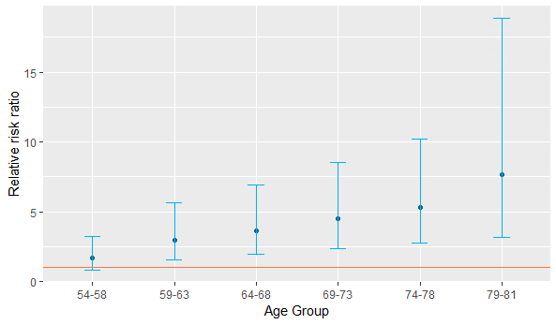
Primary Analysis: Age vs Specificity
Risk of misclassification among patients without WHI-adjudicated colorectal diagnosis (false positive)
Monotonic increasing trend in risk for elder group.

Slide 13
Secondary Analysis
Population:
WHI participants who enrolled in the Hormone Trials (both E-alone and E+P trials)
WHI participants from the two treatment arms and the two placebo arms are pooled separately for the overall analysis
Goal 1: Compare the two methods using hormone trial participants
To calculate and compare the hazard ratios and risk differences using the CMS algorithm and the WHI adjudicated outcomes
Goal 2: Compare baseline characteristics
To compare baseline characteristic for participants with and without the Medicare FFS coverage for generalizability

Slide 14
Secondary Analysis: Method
To compare if the difference between the groups is significant, we obtained p-values using t-test for continuous variables and ANOVA for categorical variables
Cox Proportional Hazards model
Hazard ratios between the pooled treatment and placebo groups for WHI data and Medicare data
Censor patients if they did not have a colorectal cancer outcome before the end dates of the E-alone trial or the E+P trial.
Use bootstrap to compare the difference (95% CI) between the hazard ratio and the risk difference from WHI and Medicare data

Slide 15
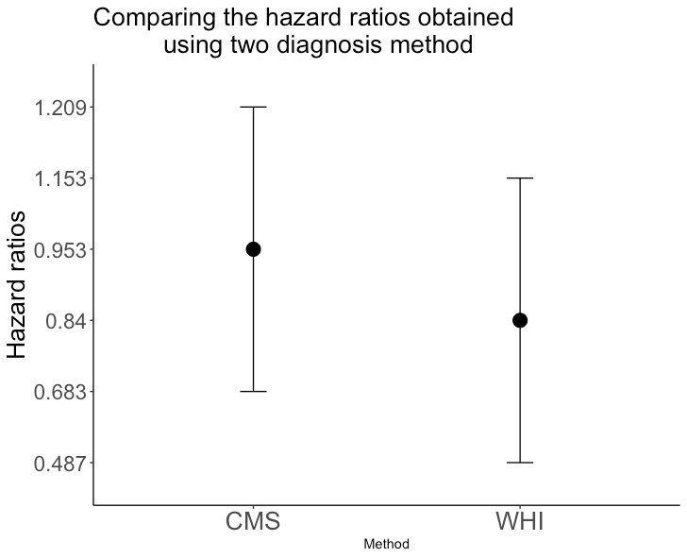
Secondary Analysis: Ratio of Hazard Ratios
The hazard ratio using the CMS algorithm: 0.95 (95% CI: 0.68,1.2)
Hazard ratio obtained using the WHI adjudication method: 0.84 (95% CI: 0.49, 1.2)
The ratio between the two hazard ratio: 1.2 (95% CI: 0.82, 1.4), with a corresponding p-value of 0.49.
Notes:
Possibilities: CMS less accurate that introduced some noise (think through this more)

Slide 16
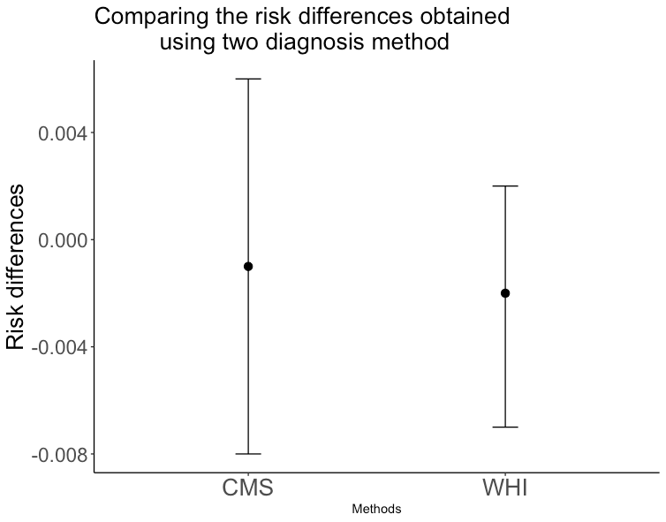
Secondary Analysis: Difference between Relative Risks
Risk difference using the CMS algorithm: -0.001 (95% CI: -0.008, 0.006).
Risk difference using the WHI adjudication method: -0.002 (95% CI: -0.007, 0.002)
The difference between the two values: 0.001 (95% CI: -0.006, 0.008), with a corresponding p-value of 0.50

Slide 17
Secondary Analysis: Generalizability of the algorithm
 | Medicare FFS (N = 19,204) | Not Medicare FFS (N = 8,143) | p-value
E-alone trial | 7,501 (39.1%) | 3,238 (39.8%) | 0.281
E + P trial | 11,703 (60.9%) | 4,905 (60.2%) | 0.281
Age at enrollment | 64.08 (6.69) | 61.79 (8.06) | <0.001*
Years since menopause | 16.14 (9.14) | 14.30 (9.70) | <0.001*
Prior hormone therapy | 6,535 (34.0%) | 2,974 (36.5%) | <0.001*
Diabetes | 1,112 (5.8%) | 444 (5.5%) | 0.279
Hypertension | 6,600 (34.6%) | 2,553 (31.7%) | <0.001*
Hypercholesterolemia | 2,421 (14.1%) | 9,45 (12.7%) | 0.002*
Ever smoked | 9,452 (49.6%) | 4,098 (50.7%) | 0.086
Alcohol (>12 drinks) | 16,555 (86.6%) | 7,127 (88.1%) | 0.001*
BMI (>= 25 kg/m2) | 14,021 (73.4%) | 5,907 (72.9%) | 0.445
Age at enrollment, years since menopause, prior hormone therapy status, hypertension status, hypercholesterolemia status and alcohol drinking history differs significantly for participants with and without Medicare FFS
Use the algorithm with caution

Slide 18
Conclusions
Age has a strong impact on the CMS algorithm performance,
More likely to misclassify patients without colorectal cancer diagnosis a for those who enrolled in WHI at an older age
There is no significant differences between using the WHI adjudicated diagnoses and the CMS algorithm derived diagnoses.
There is no significant differences between the hazard ratios and the risk differences comparing the pooled treatment and placebo group.
We need to use the algorithm with caution when generalizing it to participants without the Medicare FFS coverage

Slide 19
Scientific Impact
Health administrative data rarely used in disease prediction settings
Compared the use of health administrative data to the traditional adjudication and documentation approach
Validated the use of Medicare data for determining colorectal cancer events in the WHI participants
Demonstrated a more cost-effective and time-saving way of leveraging health administrative data
Allowed the clients to study questions about cancer survivorship more efficiently

Slide 20
Future directions
Updating the current CMS algorithm by adding ICD-10 codes
Tuning the algorithm for better performance
Applying what we learned to the other seven cancers of interest: breast cancer, ovarian cancer, endometrial cancer, melanoma, lymphoma, lung cancer, and leukemia

Slide 21

Questions?

Slide 22
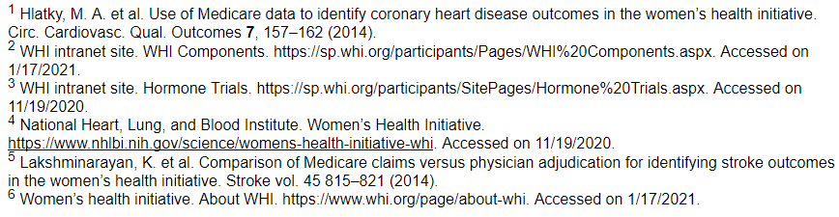
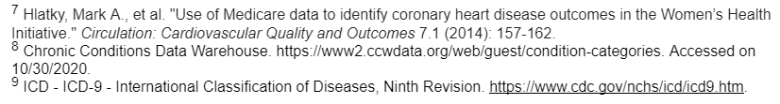
References

Slide 23
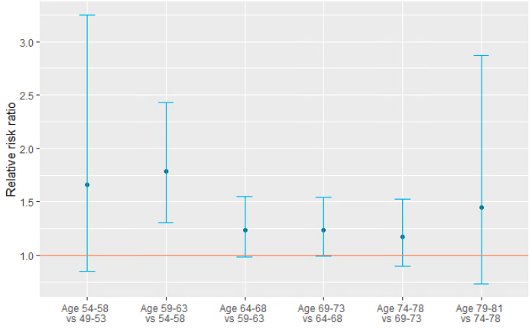
Appendix: Age vs Specificity
Risk of misclassification among patients without WHI-adjudicated colorectal diagnosis (false positive)
Monotonic increasing trend in risk for elder group.

